Slide 1
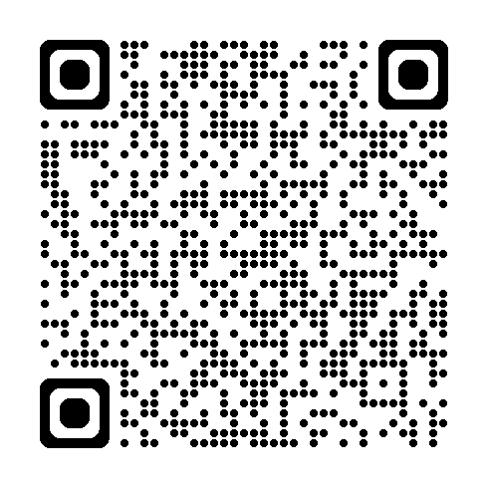

Handheld Hydrophone Kit
────────────────────────
🏷️ PROPERTY OF:
Dr. Anne Simonis, San Francisco State University
On loan from:
NOAA Southwest Acoustic Ecology Lab
📞 Contact: (715) 310-4167 ✉️ Email: asimonis@sfsu.edu
──────────────────────── 📘 User Manual: Scan the QR Code

